Slide 1
Heart Centered Metaphysics
Metaphysics I - Week II

Slide 2
Check in

Slide 3
Chapter Three Self Knowledge

Slide 4
Know Thyself: One of the most effective ways to cultivate self-knowledge and Self-knowledge is through the process of self-observation. Only by watching our thought patterns can we distinguish between what is desirable and undesirable in our consciousness.
Knowledge is Within: We must be careful not to turn self-observation into self-condemnation. The key to successful self-observation is self-acceptance.
More than our Mind

Slide 5
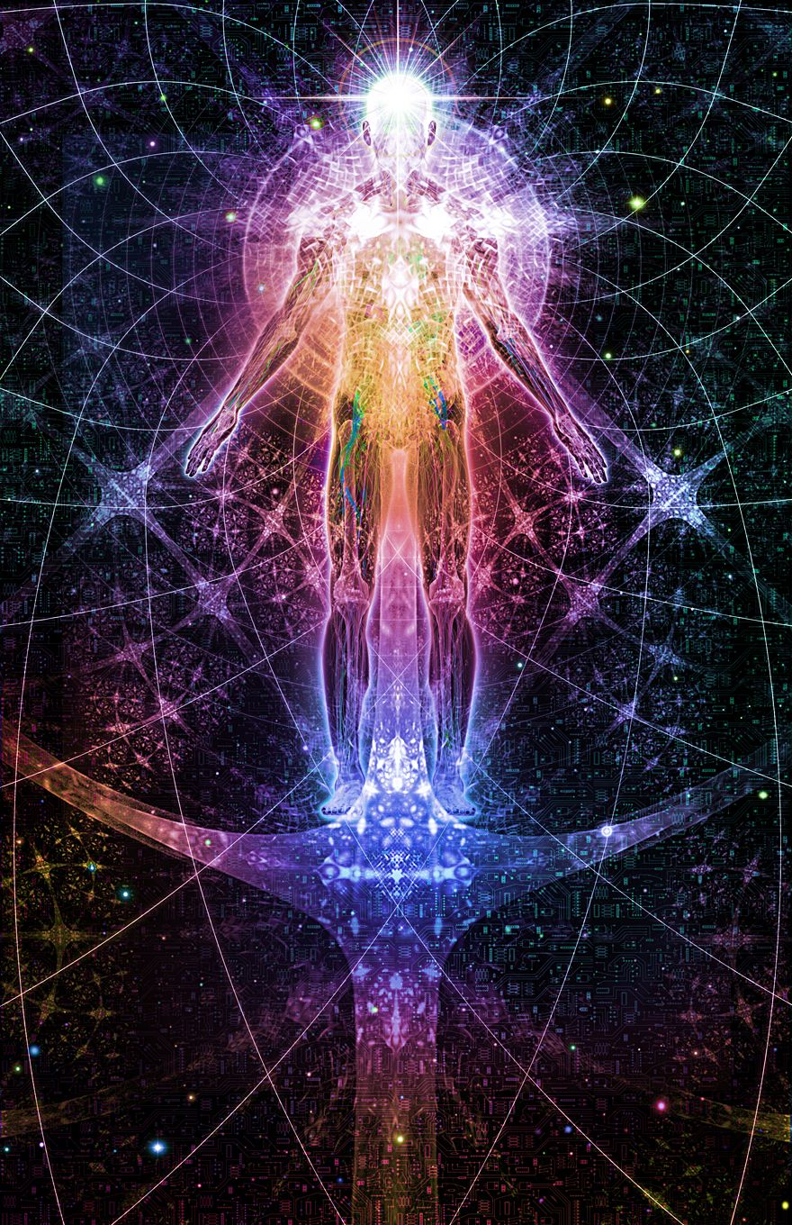
Our Many Selves
Pivotal Consciousness: The conscious can look in two directions—to the outer world where the thoughts that rise within it give sensation and feeling, which ultimate in a moving panorama of visibility; or to the world within, whence all its life, power and intelligence are derived. (Talks on Truth, p. 10)
The Great Work

Slide 6
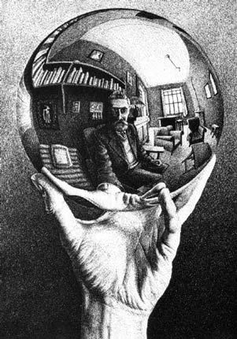
Self Observation: Some persons never take time for sincere and calm self-observation and consequently find it difficult, even impossible, to change their consciousness.
Self-observation must not become self-condemnation.
Our Goal
Security and Self Confidence: True success and self-confidence come from the knowledge and realization that Christ is the What of us.

Slide 7
The First and Second Birth
Chemicalization
Nonresistance
Crucifixion
Resurrection
Regeneration
Eternal Life
Reincarnation

Slide 8
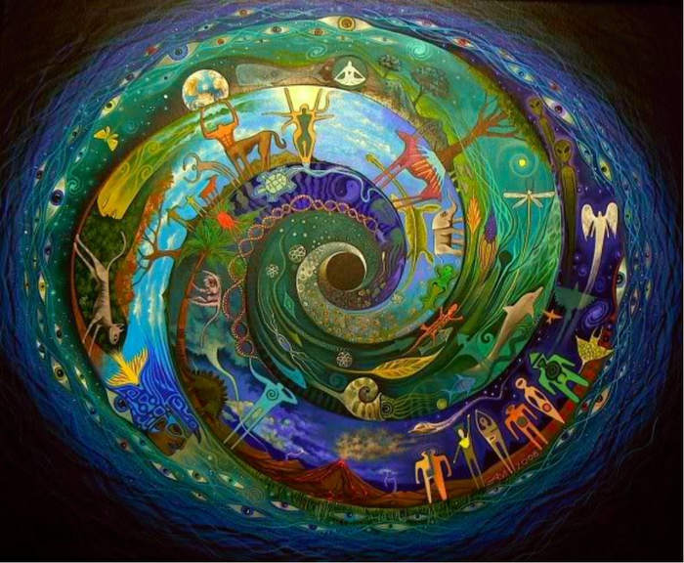
Let’s talk about it.

Slide 9
PIVOTAL CONSCIOUSNESS The conscious can look in two directions—to the outer world where the thoughts that rise within it give sensation and feeling, which ultimate in a moving panorama of visibility; or to the world within, whence all its life, power and intelligence are derived. (Talks on Truth, p. 10)

Slide 10
CHAPTER FOUR
EVOLVING SPIRITUAL AWARENESS, BUILDING CHRIST CONSCIOUSNESS
Our Process and Goal:
If you would bring forth the very best that is in you, study the methods of Jesus.

Slide 11
Evolution of Spiritual Awareness: Step by step, thought added to thought, spiritual emotion added to spiritual emotion—eventually the transformation is complete. It does not come in a day, but every high impulse, every pure thought, every upward desire adds to the exaltation and gradual personification of the divine in humankind and to the transformation of the human. The “old person” is constantly brought into subjection, and his or her deeds forever put off, as the “new person” appears arrayed in the vestments of divine consciousness. (Charles Fillmore, Atom-Smashing Power of Mind, Unity Books, Unity Village, Mo., 1949, p. 124)

Slide 12
Evolution of Consciousness: He used the power of the spoken word to penetrate deeper and deeper into the awareness of Omnipresence, Divine Mind, thereby removing the mask of personality while realizing Oneness. He then lived from that Oneness.
Some persons never take time for sincere and calm self-observation and consequently find it difficult, even impossible, to change their consciousness.
We want to remember that an important part of self-knowledge is self-acceptance.

Slide 13
The First and Second Birth: The first birth is the human—the self-consciousness of a person as an intellectual and physical being; the second birth, the being “born anew,” is the transformation and translation of the human to a higher plane of consciousness as the Child of God. The second birth is that in which we “put on Christ.”
Chemicalization is the experience of inner conflict and upheaval that often occurs when aspects of our consciousness resist the transformation process. This happens when a high spiritual realization conflicts with a belief that is contrary to the new realization.

Slide 14
NONRESISTANCE: “Things may happen around you, and things may happen to you, but the only things that really count are the things that happen in you.”
CRUCIFIXION: The crossing out in consciousness of errors that have become fixed states of mind …. (The Revealing Word, p. 46)
When the crucifixion comes and you are suffering the pangs of dying error, you may cry out, “My God, my God, why hast thou forsaken me?”
Resurrection: is a rising into new vigor, new prosperity; a restoration to some higher state. It is absurd to suppose that it applies only to the resuscitation of a dead body. (Atom-Smashing Power of Mind, pp. 119-20)

Slide 15
REGENERATION: The person calls his or her faculties out of their materiality into their spirituality. This process is symbolized by Jesus’ calling His apostles. (Charles and Cora Fillmore, The Twelve Powers)
ETERNAL LIFE: God is life, and humankind [humankind’s Divine Nature] is life. But life in its essence and life as seen in the living are not identical. The sense man [the personal person] looks on living, moving things and says, “This is life.” It is not life, but only the evidence of life.

Slide 16
Reincarnation: Soul is the sum of conscious mind and subconscious mind. (On the test)

Slide 17
Thank You!
someone@example.com

