Slide 1
Heart Centered Metaphysics
Metaphysics 1 - week 3

Slide 2
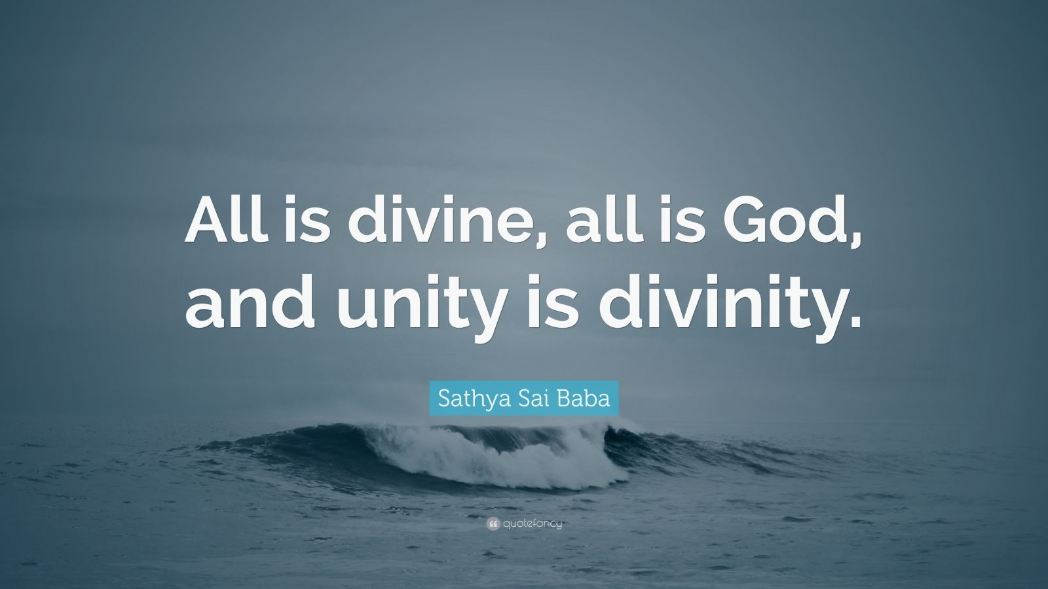
Divine Will – Divine Plan – Divine guidance

Slide 3
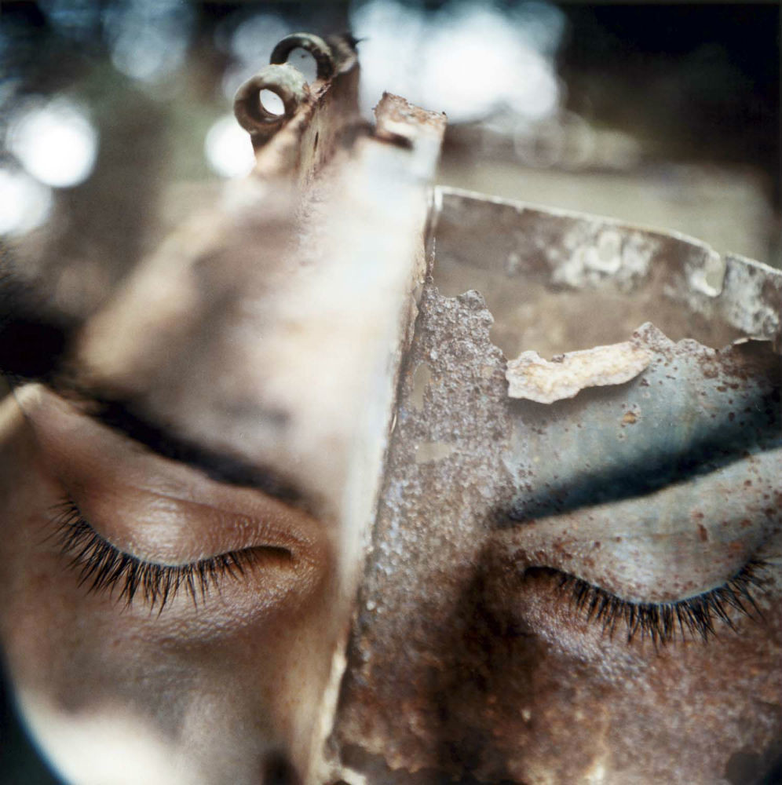
INDIVIDUALITY / PERSONALITY
Metaphysical meaning of individuality (rw)
Individuality - The true self; that which is undivided from God; our spiritual identity; the God part of us. That which characterizes one as a distinct entity or particular manifestation of divine Principle. Individuality is eternal; it can never be destroyed.

Slide 4
Metaphysical meaning of personality (rw)
Personality - The sum total of characteristics that man has personalized as distinct of himself, independent of others or of divine principle. The word personality as used by metaphysicians is contrasted with the word individuality. Individuality is the real; personality is the unreal, the mortal, the part of us that is governed by the selfish motives of the natural man.

Slide 5
Divine will
Will of God - God’s will is always perfection and good for all God’s children … God does not will suffering or imperfection in any form.
Charles Fillmore, The Revealing Word: A Dictionary of Metaphysical Terms,

Slide 6
DIVINE PLAN

Slide 7
The Divine Plan is how each person decides to bring forth, develop and express Divine Will. It is not the same thing as predestination because there is not a predetermined way for each person.
While the Divine Plan is about revealing and expressing our Divinity, we still have free will, the freedom of choice. At any given moment, each person decides whether and/or how much Christ Nature he or she will reveal and express.

Slide 8
DIVINE GUIDANCE
Divine Guidance is a magnificent flow of Infinite Mind that discerns the road ahead and helps formulate and implement the Divine Plan.
It is an “urge and energy through which you can make the choice that is best in terms of your own consciousness.”

Slide 9
The silence

Slide 11
When you pray, enter into your hidden chamber and shut the door. The Gospel of Matthew; parallel: Thomas
Shut out the physical world control the mind. Then you will become free. Krishna, The Bhagavad Gita
Meditate deeply. Dhammapada
Close the door and shut out the senses. Do this and you will never be exhausted. Lao Tzu, The Tao Te Ching

Slide 12
https://www.truthunity.net/audio/myrtle-fillmore/healing-letters

Slide 13
Thank You!
someone@example.com

