Slide 1
Metaphysics 1
Week four

Slide 2
The Silence / Meditation
Pray in
Check in
Experiences in the Silence

Slide 3
Forward
If you have the belief that the silence is mysterious or difficult, just forget your experience for a time.
Let us study together the simple means by which we may commune with God and the ways by which we may most effectively appropriate the blessing of the ancient, sacred practice

Slide 4
Purpose
Shakespeare said, "All the graces of mind and heart slip through the grasp of an infirm purpose.“
It is foolish for one to go to a spring for a bucket of water, without a bucket in which to receive the waters thereof. Likewise a person going into the presence of God should be as an empty vessel into which may be received in full measure all the elements of that divine presence.

Slide 5
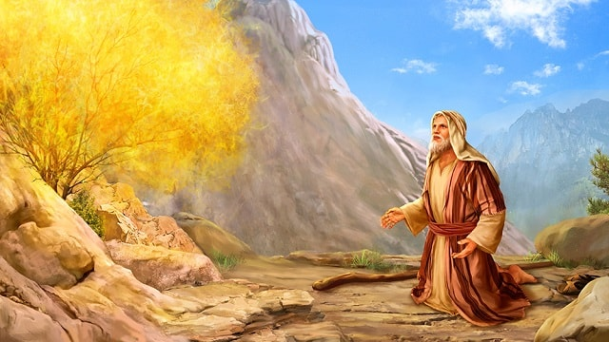
The Silence Not Negative
Think, if you will, of the condition of Moses' mind when in the presence of the burning bush he heard the command "Put of thy shoes from of thy feet, for the place whereon thou standest is holy ground."
Can you picture anything but the most perfect attention, the most absolutely awake and alert mind, the most profound interest?

Slide 6
Draw not nigh hither: put off thy shoes from off thy feet, for the place whereon thou standest is holy ground"?
Man, in his eagerness to know and to enter into spiritual life overlooks the law and, in his ignorance, wanders in "where angels fear to tread." Hence, man is warned to put his shoes from off his feet, which means that he must remove the limitations of material understanding in order to realize the holy ground, or wholeness and unity, of divine substance.

Slide 7
Man is first attracted by the phenomenal side of spiritual things; then when he gives his attention for the purpose of knowing the cause, the Lord reveals himself.
When Moses turned aside and began to investigate, he found he was on holy ground. The forces of the spirit at the center of man's body are so intense that the outer consciousness cannot stand the current and hold itself together. Absolutely pure in essence, this inner fire must be approached by the pure spiritual thought. The removing the sandals is symbolical of this taking from the understanding all material concepts.

Slide 8
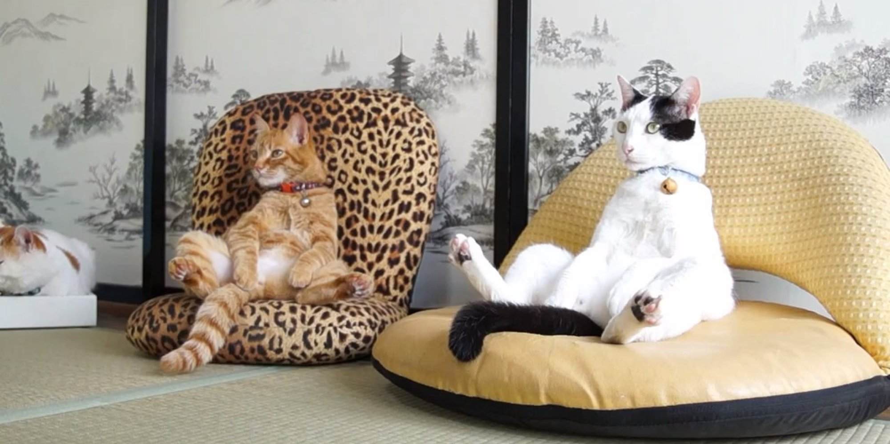
Relaxation is the state of complete mental and physical freedom—freedom from the limitations of the mind and flesh, and realization of the infinite power and presence of God actively expressing itself through every department of your being.
Nothing ever becomes ours until we accept it, because acceptance is the first requisite to ownership. Any amount of wealth may be yours potentially, but until you lay hold of it you do not possess it for any practical purpose.

Slide 9
Tendency to Sleep
Page Turner or Shop Manual?
When you become as much interested in what God has to reveal to you as you are in your storybook, you will have no further difficulty in staying focused.

Slide 10
Attention
The matter of centering the attention on an invisible force is not a difficult thing.
Just sit quietly for a moment and give your attention to the air.
You cannot see it, hear it, smell it, taste it, or feel it though you may have heard and felt its action.
Likewise you can contemplate the fact that there is an electrical ether, finer than the air, existing in you, through you, and around you, just as the air is.

Slide 11
Meditation
Meditation is a process of association with the divine presence, a method of forming an acquaintance with it.
Does not your mind grow and expand through your association with nature? Much more ought the mind to grow in comprehension through its association with the presence of the All-Good.

Slide 12
Concentration
Concentration, like relaxation, is attained not through strenuous effort but through quiet means, reasonable processes, by which the mind's interest is awakened and complete attention is attained.
Above all, make the approach to the silence pleasant, interesting, joyous.

Slide 13
Inspiration
One that associates much in thought with our divine environment receives impressions from it, and his nature is altered accordingly.

Slide 14
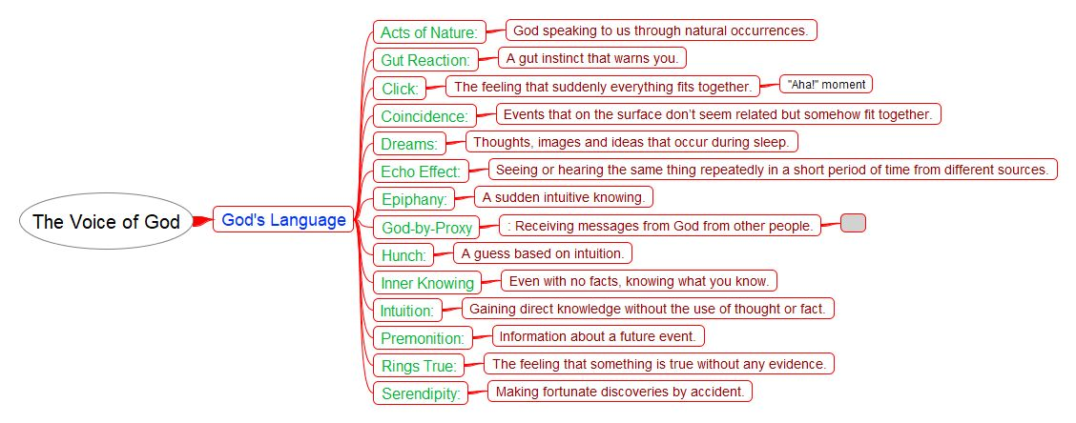

Slide 15
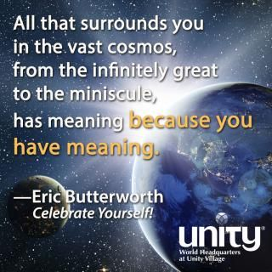
Length of Silence
“There is no time in Spirit.” Eric Butterworth
"Come now, and let us reason together, saith Jehovah." In this passage is revealed one of the most important secrets of life. "Let us reason together" does not apply only to a relationship between persons. It applies likewise to the various departments of your own being.
The silence is to soul and mind what food is to the body.

Slide 16
The Light
Every time we turn our thoughts toward the indwelling Spirit of God to contemplate its power and presence, we turn our face toward the light, "the light which lighteth every man, coming into the world."
Keep your attention turned toward it, that you may not lose a single ray of its radiance.

Slide 17
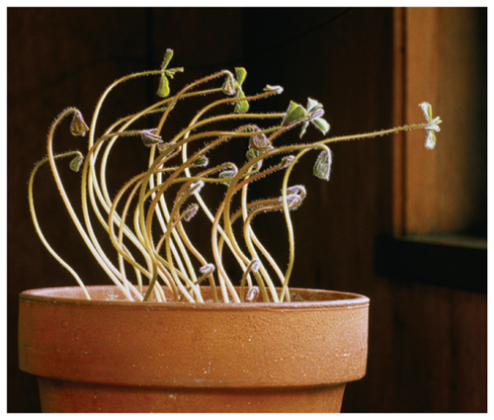
What the Silence Really Is
Knowledge is to man what light is to the plant.
every time we open our mind to receive a new idea, a new impression, or a new inspiration, we practice consciously or unconsciously, all the processes of the silence

Slide 18
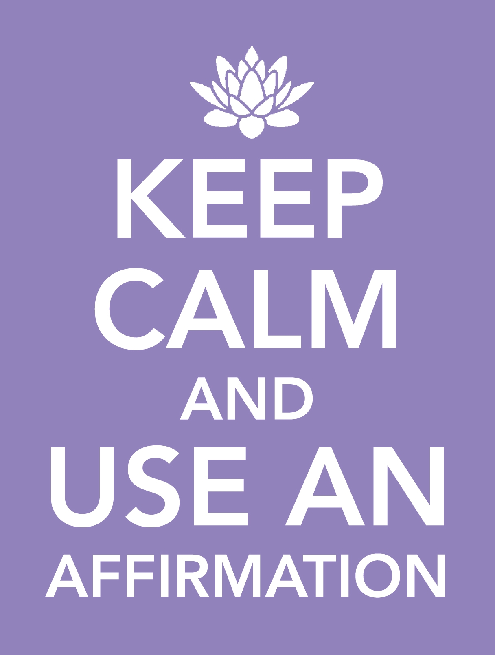
Affirmation – Quickening Energy
You can say "I am happy," affirming a desired condition, and such a statement will be helpful; but when you say “I AM HAPPY!" expressing an inward joy, it carries the power of your conviction.

Slide 19
"In praying use not vain repetitions." Just as with any other process in life, the effectiveness of affirmation lies in its intelligent, understanding use as a process designed to produce a desired result.
Do you make the correct declaration to compel something to be so, or is it because it is already so ? The fact is that you make the declaration because it is true, and this truth causes a rearrangement of the figures on the board.

Slide 20
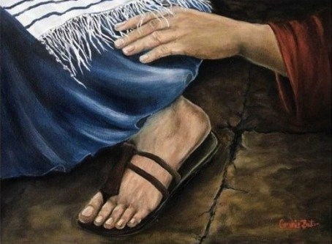
The Hem of His Garment
The moment we come into a sense of stillness we have actually become aware of the very first attribute of God—we have touched the hem of His garment.
The ideas of yesterday are inadequate to meet the demands of a growing soul. No matter how great yesterday's experience may have been, we should look forward each day in anticipation of still greater revelations.

Slide 21
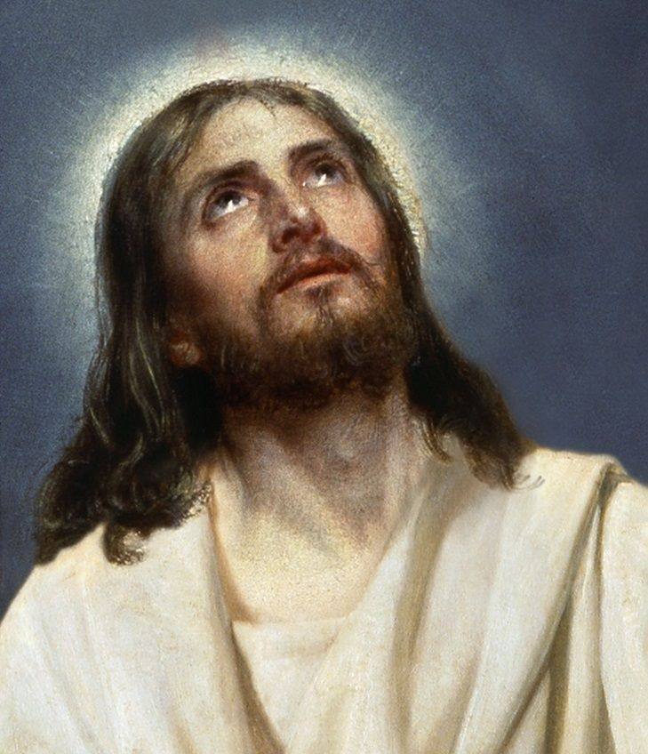
Going Within
The idea of going within originates from the scriptural teaching regarding the kingdom of heaven's being within us, and from the directions regarding prayer given by Jesus in His instruction to "enter into thine inner chamber."

Slide 22
The stillness of the canyon is identical with the silence as we refer to it, except that in the silence one has paused in the presence of God and has sent forth his call to know the nature of Being. As man waits until the reaction of his own thought processes ceases, he finds himself face to face with the Infinite.

Slide 23
Beyond the silence is the answer to every question, the fulfillment of every desire, and the solution to every problem that can arise in the experiences of life.

Slide 24
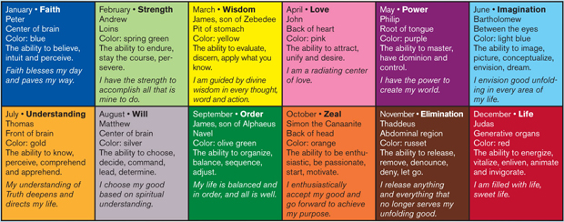
The guides into the realm beyond the silence are faith, interest, and a steadfast vision toward the highest.
It is said that God has His second best for those who will not have His best.
Dare to seek the highest; dare to approach the very heart of the Most High; dare to make direct contact with the all-knowing, all-loving Father of the universe and to let His Spirit fill your consciousness with new light, your body with new life, and your whole being with new substance.

Slide 25
Acquaintance
"Acquaint now thyself with him, and be at peace." Acquaintance comes through association, and association involves a mutual exchange of thought and feeling.

Slide 26
Thoughts coming from the very foundation of one's being, from the very source of life itself, convey a transcendent power. It should be kept in mind that ideas convey power in accordance with the source from which they arise and the realm in which they function. It is especially important that this be remembered in connection with the use of affirmation.

Slide 27
Affirmation A parrot might be taught to repeat the most intricate mathematical rule, but would it be possible for the parrot to speak with the authority and power of a mathematician who fully comprehended the meaning of the rule?
This is the exact difference between "vain repetitions" and speaking from an inner conviction of Truth.

Slide 28
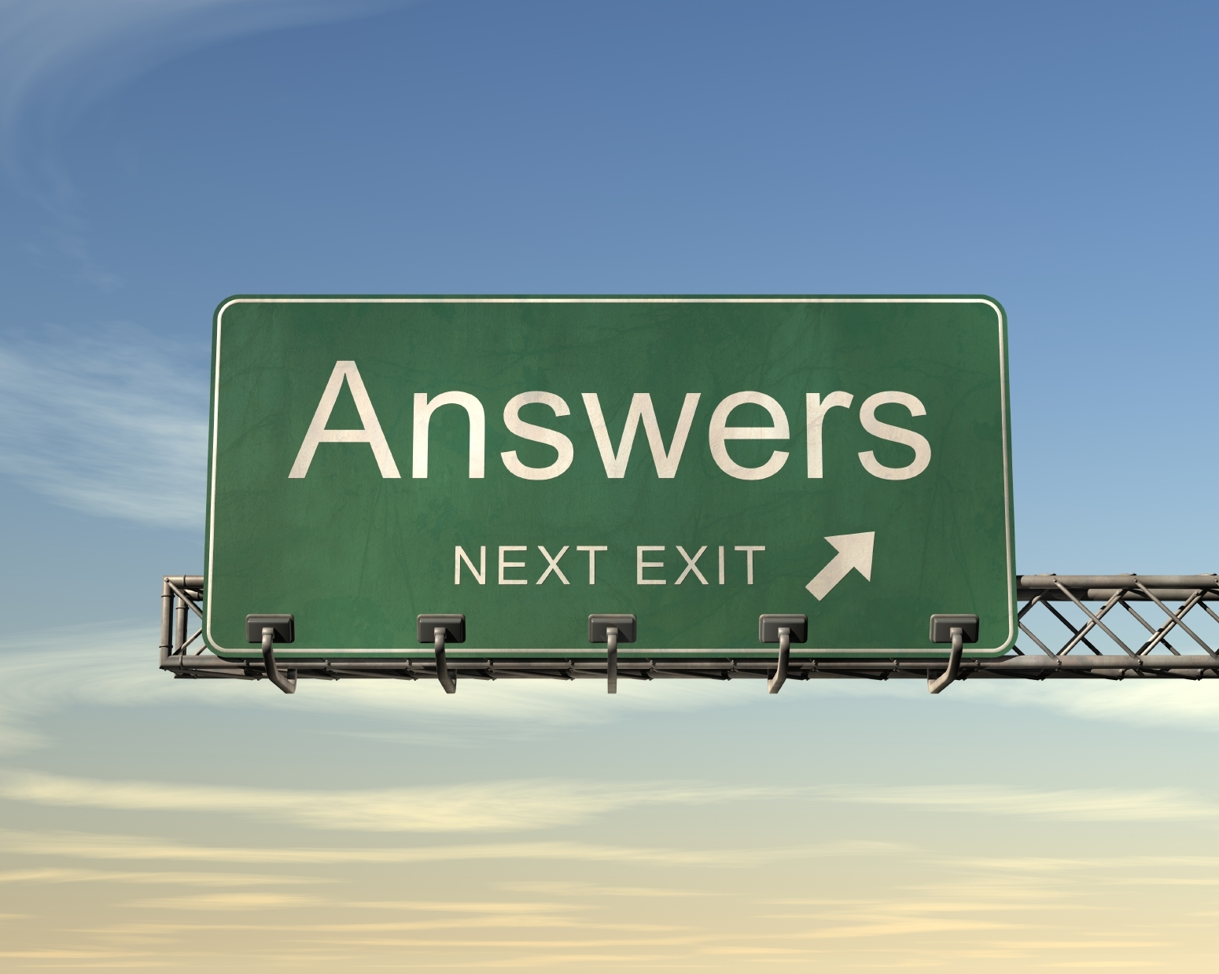
The Answer
Your work is to prepare your entire consciousness so that you may be most receptive to the inspiration of Spirit.
God does not reveal Himself to man through any sensational display of force, but through the quietness of His own nature.
Some persons receive their revelations in symbols, or in mental pictures, or in symbolical dreams. To these is given the additional task of interpreting the symbol and discovering the hidden meaning.

Slide 29
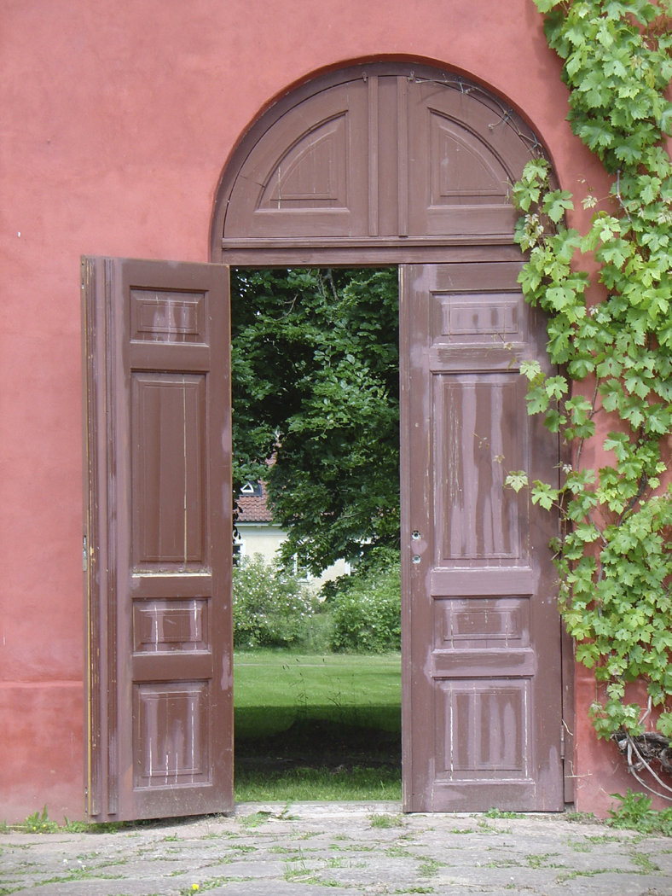
“There is but one Presence and one Power in the universe."
We say, "The answer did not come," thereby closing the door of our consciousness so that the answer, awaiting us, cannot come in. The right attitude to assume is this: "Because God knows. I also know, for I am in God and God is in me."
One must learn that, first of all, the silence is a definite opening of the mind to the revelations of the Spirit of God.

Slide 30
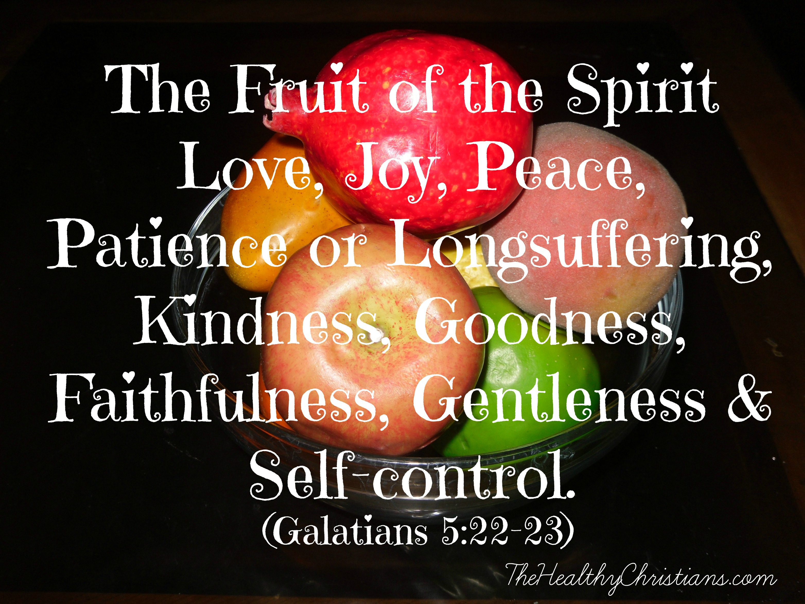
Self-Control
"All the forces of my mind and body are under the direction of divine intelligence; they are lifted up daily, supporting the Christ ideal now forming itself in me."
Say, "I am the wisdom of God made manifest; I am the love of God brought forth; I am the strength of God expressed; I am the life of God quickening all creation with living energy," as wisdom, love, strength, and life is awakened in me.

Slide 31
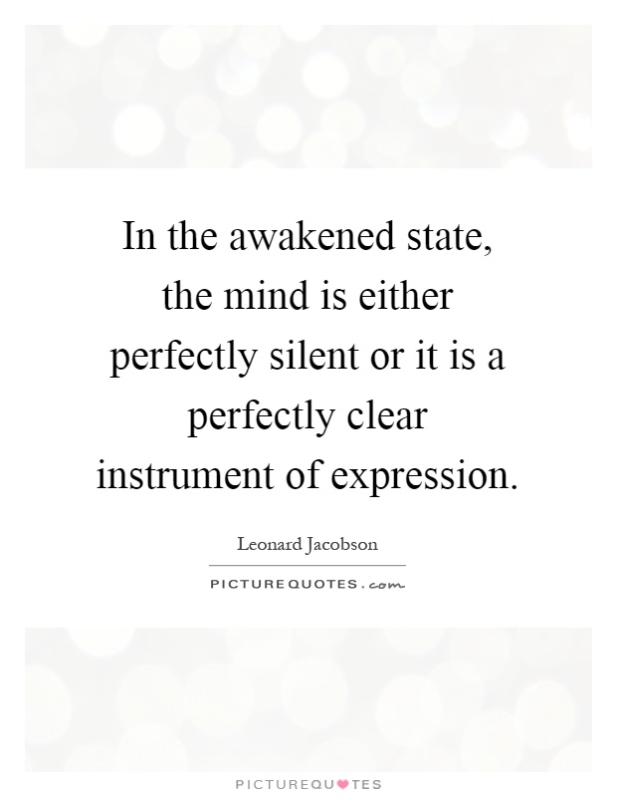
The Awakened Mind
Every bit of additional information that registers in consciousness quickens the mental processes.
Sad news makes one sad, joyous news makes one joyous, and spiritual revelation fills one with the quickening energy of Spirit.

Slide 32
The Avenue
Wherever man earnestly looks for God he will eventually find Him to some degree.
"God is Spirit, and the things of God are spiritually discerned."

Slide 33
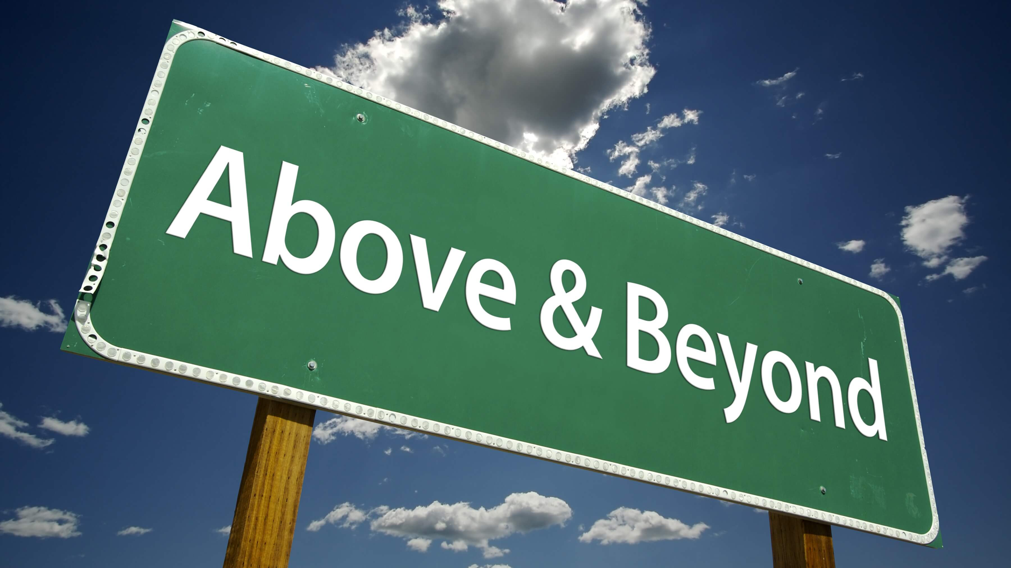
The Spirit of truth you have always with you, and it is your eternal and sure guide into the way of all Truth; it will speak to you if you listen for its words.

Slide 34
100% of your generous Love Offerings go to Unity of Melbourne to support classes and events like this.

