Slide 1
Metaphysics 1
Week 5

Slide 2
Check-In

Slide 3
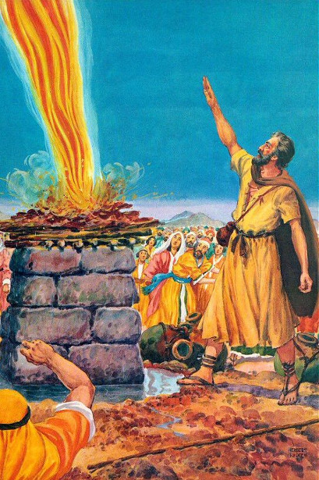
Metaphysical meaning of Elijah (mbd)
Meta. The spiritual I AM of man's consciousness. Elijah on Mount Carmel (I Kings 18:19) represents the I AM in realization of its unfettered power.

Slide 4
Metaphysical meaning of fire (rw)
fire--Symbolizes cleansing and purification, but it is more than a symbol. Material fire is the symbol, and the fire of Spirit is the reality. The whole universe is alive with a divine, living, spiritual energy that consumes all the dross of sense and materiality. It is a fire that burns eternally.
Because this is true, some have assumed that disobedient, sinful persons are to live forever in everlasting torment. But if the fire is eternal, the dross is not, and when the error is consumed the burning stops. The fire consumes only when it meets anything unlike itself.
In purified man it is manifested as his eternal life.

Slide 5
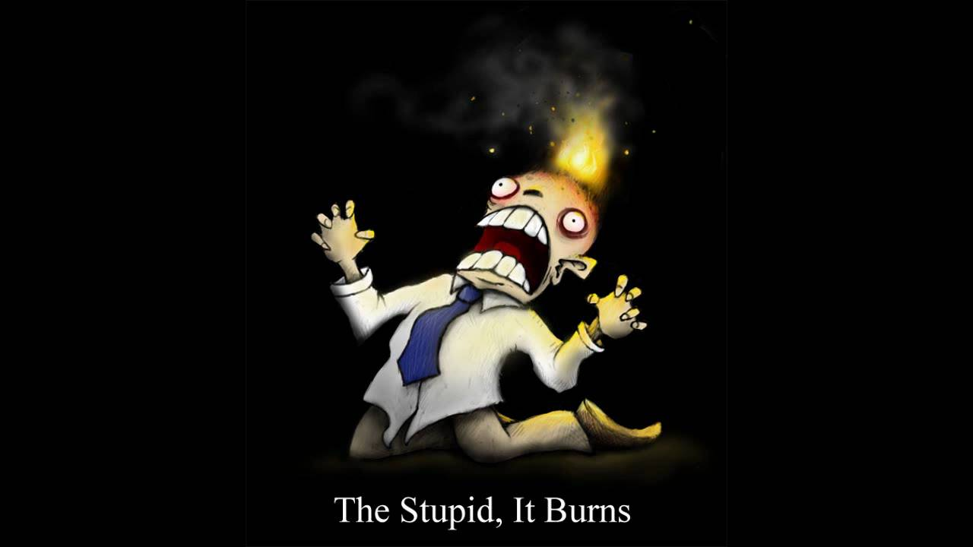

Slide 6
Metaphysical meaning of miracle (rw)
miracle--"An event or effect in the physical world beyond or out of the ordinary course of things, deviating from the known laws of nature, or transcending our knowledge of these laws" (Webster). In reality miracles are events that take place as a result of the operation of a higher, unknown law. All true action is governed by law. Nothing just happens. All happenings are the result of cause and can be explained under the law of cause and effect.

Slide 7
Mighty things have been wrought in the past by those who had mere blind faith to guide them. To faith we now add understanding of the law, and our achievements will be a fulfillment of the promise of Jesus, "He that believeth on me, the works that I do shall he do also; and greater works than these shall he do" (John 14:12).

Slide 8
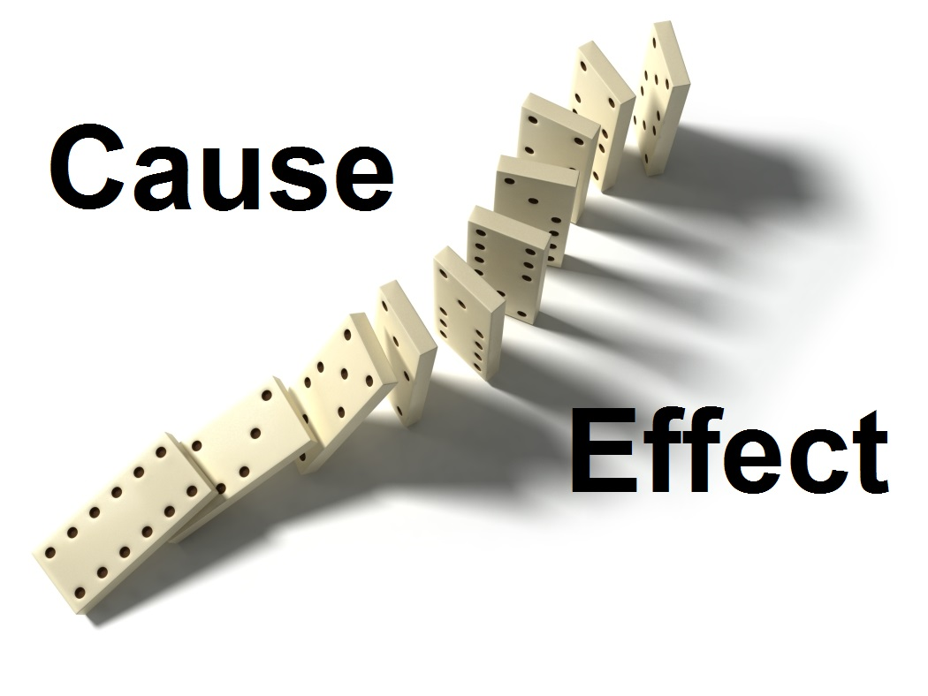
Metaphysical meaning of cause and effect (rw)
cause and effect--The law of sequence; the balance wheel of the universe. This law, like all other divine laws, inheres in Being and is good. "Whatsoever a man soweth, that shall he also reap" (Gal. 6:7). Man lives in two worlds, the world of cause (the within) and the world of effect (the without).

Slide 9
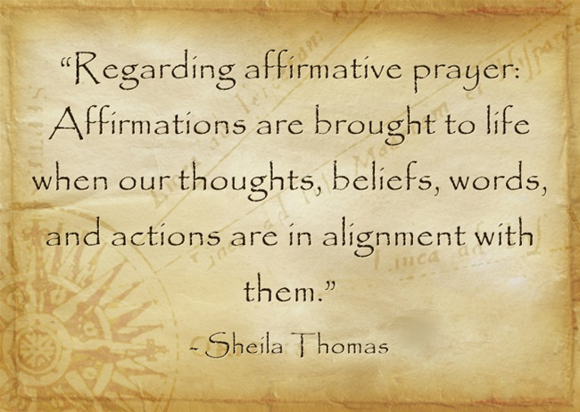
Prayer
Affirmative prayer is the act of claiming and declaring what is already True in the Absolute Realm.
In heart-centered metaphysics, prayer is both a head and heart, thinking nature and feeling nature process.

Slide 10
Mind
God is a great mind reservoir that has to be tapped by the human mind and poured into visibility through human thought or word. (Charles Fillmore, Jesus Christ Heals.
True prayer requires much more than the repetition of memorized words. Prayer is an attitude of the heart that is more about being than doing.

Slide 11
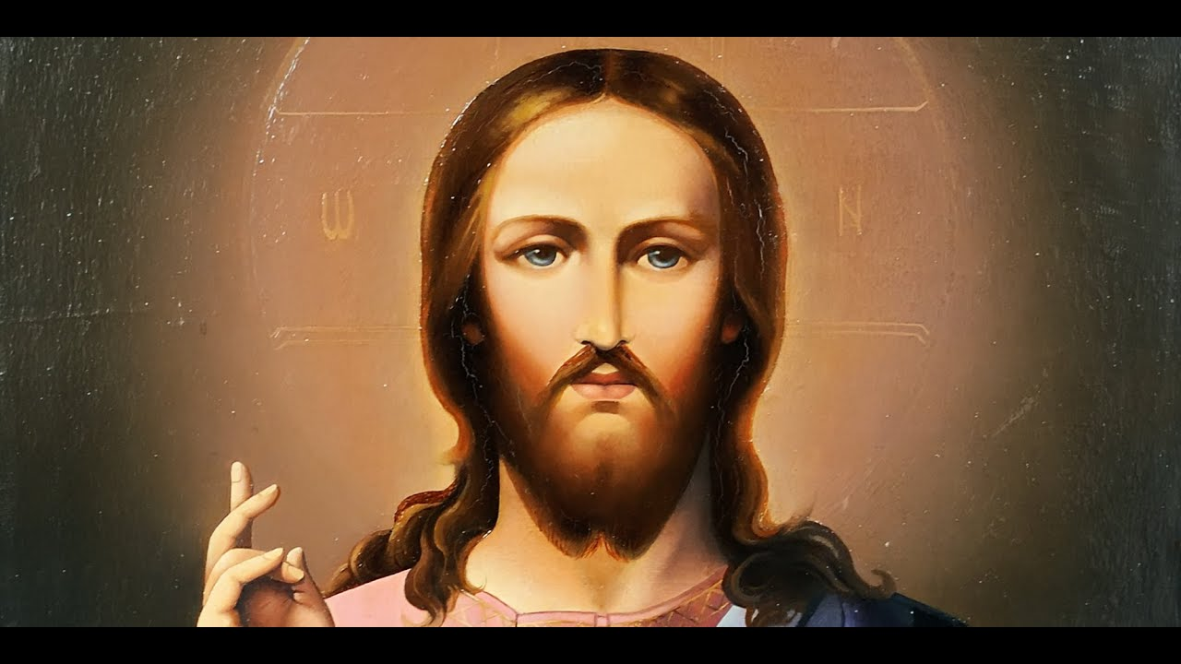
Affirmative Prayer
“The kingdom of God is within you.”
Prayer is the most highly accelerated mind action known.
Instead of a supplication, prayer should be a jubilant thanksgiving.

Slide 12
Affirmative prayer is the spiritual activity in which we enter into conscious remembrance of Oneness, or Divine Nature. In an attitude of gratitude and love, affirmative prayer celebrates this Oneness.
It is not praying to God nor being grateful to God, nor is it asking God for something or to do anything.

Slide 13
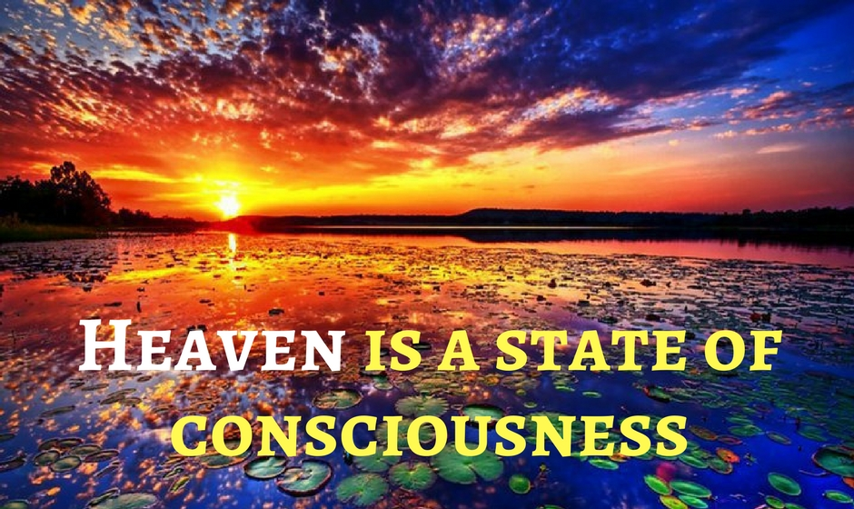
Affirmative prayer is praying from the Consciousness of Divine Mind (Oneness) knowing, realizing, claiming and declaring what is already True.
While the thinking nature is certainly involved, it is vital that we feel what is True.

Slide 14
Divine Ideas
True prayer is not asking for things, not even the best things. Prayer is the lifting of the consciousness to the place where these things are. (Sue Sikking, A Letter to Adam.)
These ideas may flash into our minds in answer to prayer, or they may be conveyed to us through the words of other people, or through books, magazines, or newspapers. (Vera Dawson Tait, Take Command)

Slide 15
Divine Ideas; they are always fully available and cannot be depleted or annihilated.
Prayer is the most effective way we can fulfill our creative potential.

Slide 16
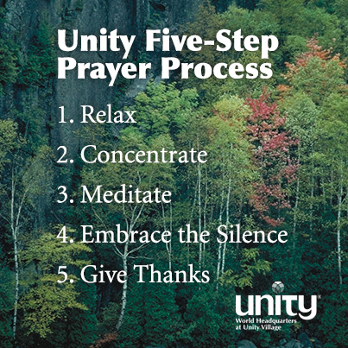
FIVE-STEP PRAYER PROCESS
We start with an intention to gratefully and lovingly enter into a time of prayer.
Relaxation, Concentration, Meditation, Realization, and Thanksgiving.

Slide 17
RELAXATION
When a body of water is choppy with fitful currents of air it cannot reflect objects clearly.
CONCENTRATION/INTENTION AND ATTENTION
As a lens focalizes the sun’s rays at a given point—and we know how intense that point of light may become—so concentration focalizes the mind on a single idea until it becomes manifest and objective. Charles and Cora Fillmore

Slide 18
Concentration, one-pointed attention, forms a mental magnet in the mind to which thought substance rushes like iron filings to a loadstone. Then follows confidence or faith in one’s ability to accomplish the desired end. (Jesus Christ Heals)
Similar to contemplative prayer, concentrated attention is the gentle focusing of the mind on a particular statement or thought of Truth.

Slide 19
For instance, in praying about prosperity, the Truth Idea concentrated upon might be Abundance.
In praying for healing, the Truth Idea might be Life that expresses as wholeness and health.
In a way, holding these thoughts serves as a kind of mantra during meditation.

Slide 20
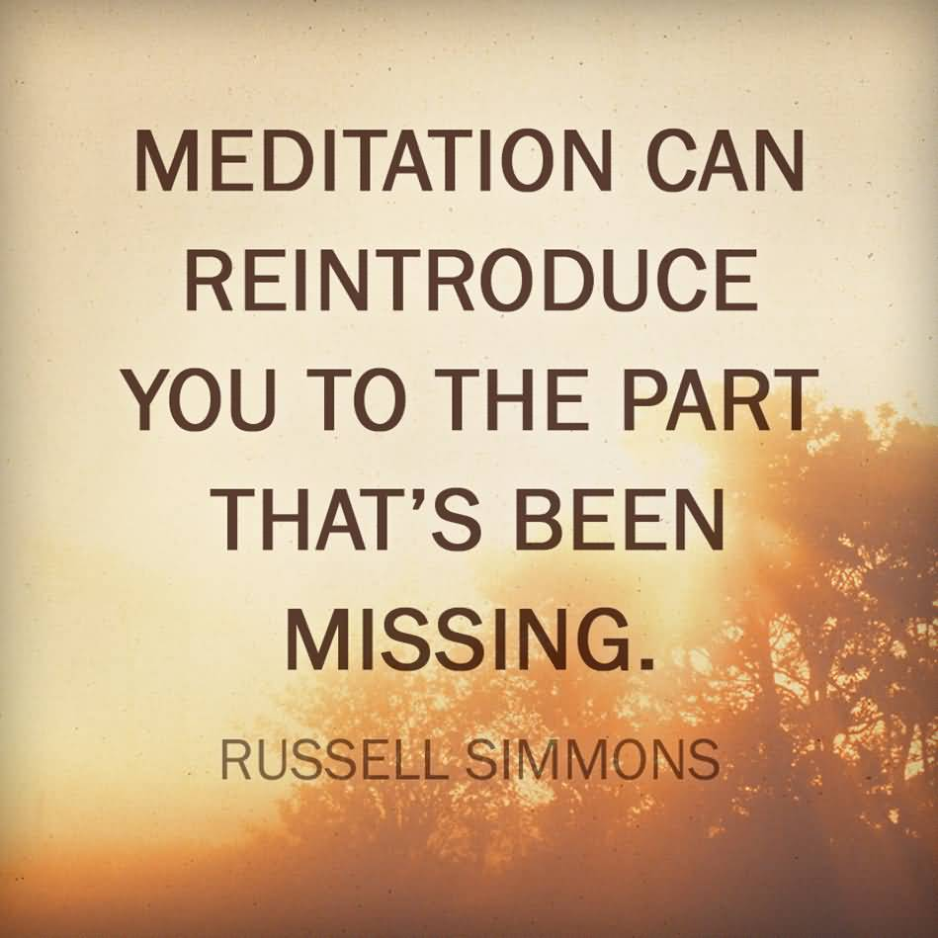
MEDITATION
To open yourself to the inspiration of your indwelling Lord and then to listen for Its inspiration, this is meditation. (May Rowland, The Magic of the Word)
We are “just this side of the Silence” when we become aware of Divine Ideas and Divine Inspiration.

Slide 21
REALIZATION
To a metaphysician, realization is the conviction that a person gets when he or she has persistently concentrated attention on an ideal until assurance of the fulfillment of that idea is felt. (Jesus Christ Heals, p. 45)
The deep inner conviction and assurance of the fulfillment of an ideal.
Persist in prayer until there is a deep inner knowing, a deep conviction of Truth, and then stop thinking about or even looking for manifestation.

Slide 22
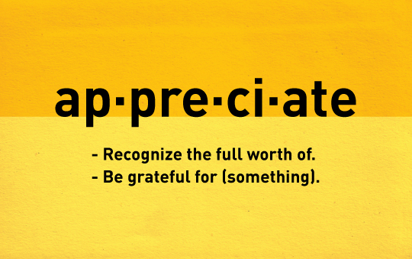
THANKSGIVING
Praise and thanksgiving impart the quickening spiritual power that produces growth and increase in all things. (Charles Fillmore, Prosperity)
Also recall that we are grateful before our answer appears, before the realization of Divine Ideas.
Knowing Faith

Slide 23
PRAYER WITHOUT CEASING
We are always laying hold of Divine Ideas and manifesting them according to our level of consciousness. “Putting God in charge of our lives” means putting Divine Mind in charge of our lives; it is investing ourselves in the awareness of Divine Mind, or Oneness, so that we are living from It.
Cause and Effect

Slide 24
Denials and affirmations cleanse our consciousness of error beliefs as well as help to release mental tensions and distractions so we are able to claim the Truth we know.

Slide 25
PRAYING WITH OTHERS
To be clear, our use of the term healing does not mean “cure.”
For the purposes of this text, cure is when a person moves from illness to health without a change of consciousness.
Healing is always about a change in consciousness first; it is a change from error thinking to Truth.

Slide 26
PRAYING FROM, NOT TO
Jesus said, “I and the Father are one.” We must have this more intimate acquaintanceship or communion with creative Mind if we are in all ways to do His will. (Charles and Cora Fillmore, Teach Us to Pray)
We do not really pray to God, rather we pray from a consciousness of God. Prayer is self-realization, self-expansion. It is getting centered within, and reestablishing ourselves in the flow of the infinite creative process. (Eric Butterworth)

Slide 27
THE OBJECT
Remember that the object of all treatment is to raise the mind to the Christ consciousness, through which all true healing is accomplished. (Teach Us to Pray, p. 178)

Slide 28
MIRACLES
The underlying meaning is that when a person unifies with God, a spiritual power works for him or her in ways that are incomprehensible to human reason and superior to human might. (Elizabeth Sand Turner)
The forces invisible are much closer than we think, and when we turn our attention in their direction the response is usually so pronounced and so swift that we cannot but feel that a miracle has been performed.

Slide 29
By the power of his thought Elijah penetrated the atoms and precipitated an abundance of rain. By the same law he increased the widow’s oil and meal. This was not a miracle—that is, it was not a divine intervention supplanting natural law—but the exploitation of a law not ordinarily understood.
Jesus used the same dynamic power of thought to break the bonds of the atoms composing the few loaves and fishes of a little lad’s lunch—and five thousand people were fed. (Charles Fillmore, Atom-Smashing Power of Mind)

Slide 30
RELEASING
If you would help someone else in need of healing, you first must be free in your own mind from anxious thoughts concerning him or her before you can give a real blessing.
Anxious thoughts will leave as you consciously know that the healing power of God is active in the person now, that the healing work is being done perfectly. (Martha Smock, Halfway Up the Mountain,

Slide 31
RESISTANCE AND PERSISTENCE
the one who prays must persist in this prayer until the walls of resistance are broken down and the healing currents are tuned in. Metaphysicians often pray over a critical case all night. (Charles Fillmore, Jesus Christ Heals)
Whatever the case, the solution is always the same: persist in prayer until confident that realization has been fully achieved and then let go.

Slide 32
REALIZATION
Mind is the common meeting ground of God and humankind, and only through its study and the observation of all the conditions and factors that enter into its operation can we come into the realization of God as abiding health and sustenance. (Jesus Christ Heals, pp. 31-32)
Realization is a deep inner conviction of Truth; it occurs when you know and feel something is True regardless of outer circumstances.

Slide 33
Prayer for healing is about realizing Life, Wholeness and Health; it begins with going to that still point of the awareness of Divine Mind, or Oneness. From this awareness, one can achieve the realization of the Truth of Life at every level of being. It is in and from this conscious realization that we then see ourselves and others as whole and perfect. When realization occurs, there is often the awareness of what has been described as an “inner click.”

Slide 34
NO EFFORT WASTED
The law of spiritual healing involves full receptivity on the part of the one under treatment.
As our awareness of Oneness increases, we develop a heartfelt desire to bless anyone overcoming a health challenge.
we cannot insist on any particular result in those with whom we pray.

Slide 35
SEEING PERFECTION
Unity uses the word “see” in a very special sense in these instances. We do not mean “to pretend,” we do not mean “to see” in the literal sense. We are speaking, rather, of an inner acknowledgment and realization regardless of whether or not the appearance matches the acknowledgment at the moment. This is also sometimes called “holding the thought” or “laying hold of the Truth.”
When we focus on people’s illnesses we are not seeing them rightly; we are not seeing their Reality.

Slide 36
A SUGGESTED PROCESS
Refuse to see and acknowledge any appearance of illness. This may require the use of denials and affirmations (see Chapter 22).
Focus your attention and awareness on Oneness, or Divine Mind. Meditate for a while until you are dwelling in the Silence.
Once you have become still and at peace, feel and “think after” the principle of Life.

Slide 37
4. Focus your attention on Life, Spiritual Life—the vital, energizing Divine Life that produces wholeness and health. Hold on to the Principle of Spiritual Life until you have as full a realization of it as possible, until you have that sensation of the internal click that comes with knowing that you know. Know and feel the Truth of Divine Life.

Slide 38
Once centered in as full a realization as you can have of Life, bring into consciousness the person with the health challenge.
See Spiritual Life coursing from that person’s Divine Nature through every level of his or her being, radiating wholeness and health.
Fully engage your thinking and feeling natures using the power of the spoken word to claim these Truths through your Spiritual Faculty of Dominion/Power (Chapter 24, section G).

Slide 39
6. Give praise for these Truths and be in gratitude for this vitalizing Life expressing wholeness and health.
7. Continue to refuse to see and acknowledge any appearance of illness. Whenever you think of or see this person, see only Perfection. See that he or she is whole and perfect, vitalized by Spiritual Life from Divine Mind. Behold only wholeness and health.

