Slide 1
Breaking Ten
Six - Seven - Eight

Slide 2
The Sixth Commandment
An elderly man was quite unhappy because he had lost his favorite hat. Rather than purchasing a new one, he decided he would go to church and steal one out of the vestibule. When he got there, an usher intercepted him at the door and took him to a pew where he had to sit and listen to the entire sermon on the Ten Commandments. After church, the man met the preacher in the vestibule doorway, shook his hand vigorously and said, "I want to thank you for saving my soul today, preacher. I came to church to steal a hat, but after hearing your sermon on the Ten Commandments, I decided against it." "You mean the Commandment, Thou shall not steal, changed your mind?" the preacher asked. "No, the one about adultery did," the old man said. "As soon as you said that, I remembered where I left my old hat."

Slide 3
When is killing okay?
Okay When?
Not Okay When?

Slide 4
The SIXTH Commandment
You shall not kill (Ex. 20:13)

Slide 6
Jesus’ ideal was the power of transcendence. You may not be able to change the outer situation, but you can always rise above it by turning to a higher level of consciousness. We tell our children, “There is a ‘little me’ and a ‘great me’ in all of us.” The “little me” reacts in anger and seeks revenge. The “great me” is always established in love and poise. Turn the other cheek. Turn from hostility to love.

Slide 7
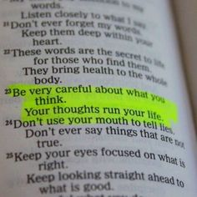
Metaphysically the only "killing" done by most people is in our inner world.
People exist in our inner world as our thoughts and feelings toward them and about them. Is everyone safe in your inner world? Or are some persons in your inner world subject to violence, perhaps even to the stage of being mentally "killed"?
The thought, the desire, the inner picturing of assassination or annihilation is tantamount the doing the actual deed (just as Jesus later says it is in regard to lust and adultery) We obey this commandment when mentally and emotionally we grant a safe-conduct pass to every person who travels in our inner world.

Slide 8
This goes to the crux of all so-called justifiable murder, such as war or capital punishment. The principle is “The incident is external; the reaction is our own.” But how we deal with them is an activity of our consciousness. There is always a price to pay!
The physical act of violence that leads to killing is really an attempt to destroy something that appears to be a threat to the person.
And yet Jesus leaves no room for explanations. He says if you are angry at someone, you have already broken the “you shall not kill” commandment. In consciousness you have already put yourself at cross-purposes with the law.
It all comes from the delusive feeling that things “out there” can hurt you or take away that which is yours. This is your own paranoia, which may be quite subtle. The sixth commandment implies that nothing exterior to you can harm you or hinder you, except as you give it entrance into your mind.

Slide 9
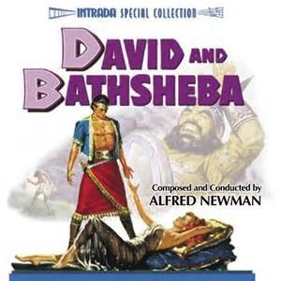
The SEVENTH Commandment
You shall not commit adultery (Ex. 20:14)

Slide 11
“Life is for Loving”
Adulterate, on the other hand, means to pollute, or to add something other.
From its Hebrew root, adultery means “a total or complete abandoning of one’s principles.” The word is made up on the word ad, meaning “to add” … and the word ulter, meaning “other.” It means “to add other” or to dilute by adding something else to a substance.
Adulterate means to add something that cheapens the quality or upsets the completeness.

Slide 12
Jesus had little patience with the old traditions that were so filled with prejudices and hypocrisy. He shattered this commandment into its minute components, again leaving no room to hide. (eg. Cast the first stone)
Whenever we see less than the Christ in another or in ourselves, we commit adultery. Does this surprise you? Again, there is no place to hide.
The commandment is broad in its application to human thought. “You shall not commit adultery.” You shall not adulterate reality by judging by appearances, and thus by adding on something other than the Truth. You shall not pollute that which is pure and holy by seeing in a mirror darkly. It is a large order.

Slide 13
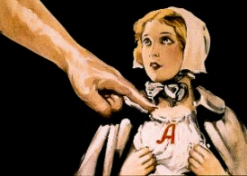
You Always Have a Choice
The word commit literally means to send forth. It is something that takes place in the mind, as an attitude, a perception, a motivation, and then goes forth into some form of action. When the attitude is negative and narrow, the action will be limited and self-destructive.
You always have a choice: Commit your way unto the Lord or commit adultery. Make the commitment to keep your thoughts on the high level of Truth. Whatever is true … honorable … just … pure … lovely … gracious .. think about these things (Phil. 4:8).
Send forth I AM power in positive words and actions or you will pollute your mind, body and affairs with habit patterns of inferiority, animosity and negation.

Slide 14
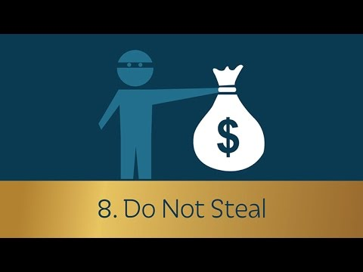
The EIGHTH Commandment
You shall not steal (Ex. 20:15)

Slide 16
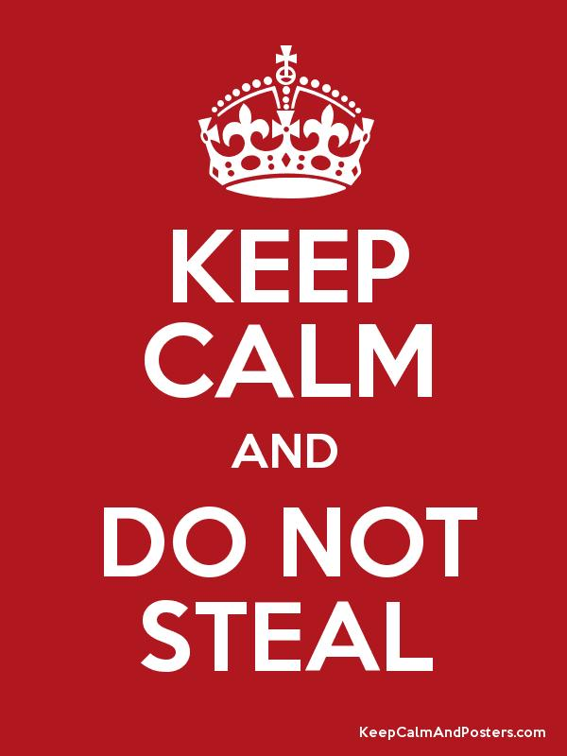
In Moses’ time the “no stealing” law was enforced very simply and realistically. If a man who stole an ox was caught, he had to repay the owner with five oxen. There were not many thieves in Israel and no jails. Stealing did not pay. Paying back five times what one had been caught stealing was a real deterrent.
…He steals from himself. Until this is realized, no laws will be effective. One must be made to realize, in a human as well as spiritual sense, that the only rip-off is a self-rip-off. He, who robs another, robs himself first. He makes a break in his own integrity or wholeness at the expense of his own ultimate good.

Slide 17
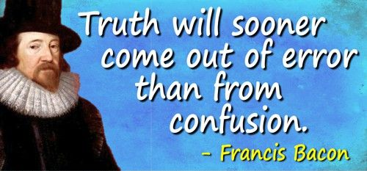
The Greek philosopher Zeno once said that the most important part of learning is to unlearn our errors. There is a legitimate, royal abundance for every living soul; but there is a price to pay. Create the conditions in consciousness that will make the result inevitable. When the pattern is formed in the mind the result will flow forth—and no matter what the observers may say, there is no luck involved.
Life is lived from within-out; Is the release of his own “imprisoned splendor.”
It is true that things and money come to us from the world “out there.” But true wealth is not the things. It is the magnetic flow of Spirit within us that draws the things.

Slide 18
The quest for Truth is that the greatest sense of fulfillment in life is not in what the magnet may attract, but in the inner sense of wholeness that comes from just being in the flow, which then is only outwardly experienced as the power to draw things and the things that are drawn.
The point to this commandment is: Your education is never complete until you really understand the law of consciousness: Whatever happens to you, whatever happens around you, will be in accord with that which is within you, your own state of mind. And whatever is in your consciousness must happen, no matter who may try to stop it. On the other hand, whatever is not in your consciousness cannot happen. Of course, you can change your consciousness. And that is what this new insight in Truth is all about.

Slide 19
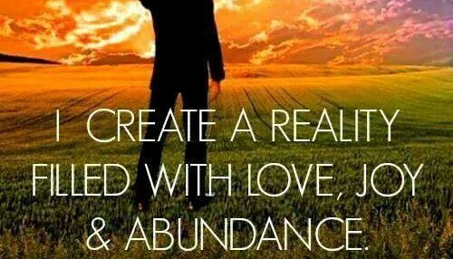
Love Offering and Closing Prayer

Slide 20
Next Week
9 & 10

