Slide 1
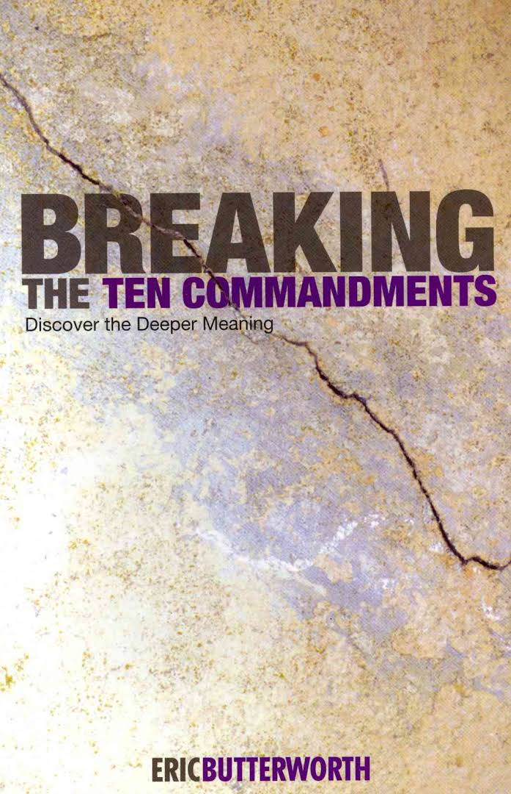
Breaking The ten commandments
Discover the deeper meaning

Slide 2
Heart Agreements
Purpose: To create a safe, healthy environment for an authentic sharing experience
Confidentiality: Everything shared by group members is confidential - not to be shared outside the group.
Acceptance & Compassion: We accept, acknowledge and show compassion for others even if we disagree with their actions or beliefs. We acknowledge others’ ability to figure out their own lives and accept where they are without judgment.

Slide 3
Heart Agreements, continued
Commitment: We commit fully to the group process experience. To do this -We commit to connecting with our facilitator if it is necessary to miss a session, it is nice for me to know who is going to come.
Respect: We respect others as people and their right to determine their own best action. We are mindful to avoid interrupting, minimizing, critical or judgmental statements, advice giving or fixing.
Truth & Integrity: We encourage and support each other in honesty – authentically expressing who we are. This is an inherent risk and only can occur in a safe and respectful environment.

Slide 4
Heart Agreements, continued
Direct Communication: We communicate directly and honestly with a pure heart and intention for healthy supportive relationships within our community. We address conflicts directly and immediately.
Participation: We actively participate knowing our perspective and wisdom is vital to the growth of fellow members and ourselves. We know our absence diminishes the energy, connected experience and sense of sacred space for growth, we as a group know that life is happening to.
Mindful of Time: Since our time together is valuable. We are mindful to stay on topic and not monopolize the group’s time, allowing a balance between sharing and soaking in the wisdom of others.

Slide 5
Heart Agreements, continued
Positive Environment: We generate positive energy to create an environment conducive for spiritual growth by being mindful to avoid complaining, gossip, criticism, or judgment. We gently but firmly remind others of our commitment to these agreements.
Love Offering: We recognize and appreciate the value of Unity of Melbourne and this program in our individual spiritual growth and development as a community. We support the sustainability of our community with our love offerings.

Slide 6
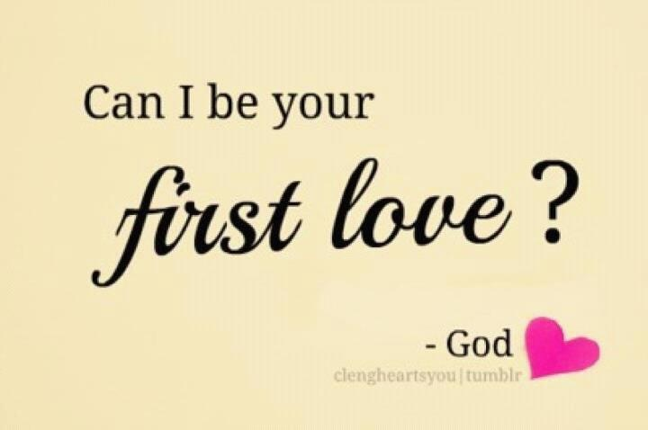
Topics and Themes
Introductions and Overview
Forming a learning community
Book discussion summarizing & finding value in the 1st Commandment
Activity: mind map
Guided Meditation/Closing

Slide 7
Meditation

Slide 8
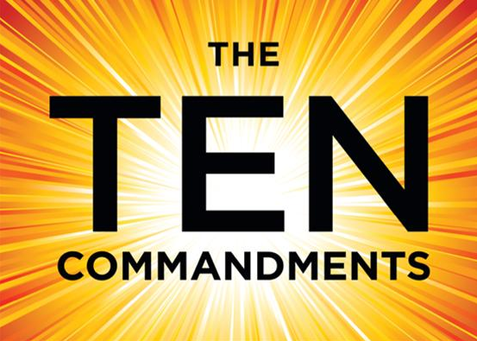
The Big 10!
According to Eric Butterworth, many people will say that while they don’t regularly attend church, or belong to any religious organization, they live deeply spiritual lives and live by the ten commandments.

Slide 9
The First Commandment
The Second Commandment

Slide 10
The Fourth Commandment
The Third Commandment

Slide 11
The Fifth Commandment
The Sixth Commandment

Slide 12
The Eighth Commandment
The Seventh Commandment

Slide 13
The Ninth Commandment
The Tenth Commandment

Slide 14
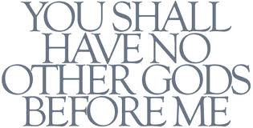
The First Commandment
Applying ancient wisdom to modern life.

Slide 15
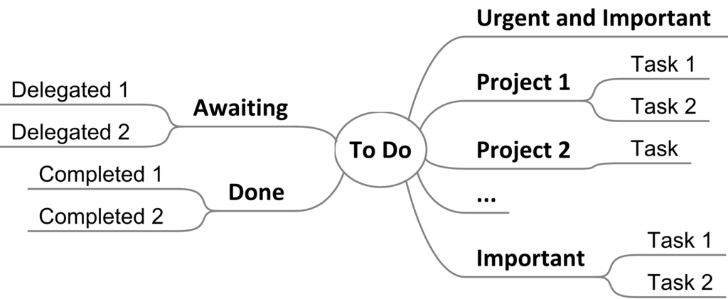
Activity: Mind Mapping

Slide 16
The First Commandment Mind Map Study
Make the center of your MindMap your name for God
For example, on the branches think about your old ideas about God, on another branch…

Slide 17
I am
I AM is God's name in man; it is Jehovah, the indwelling Christ, the true spiritual man whom God made in His image and likeness. The outer, manifest man is the offspring of the I AM, or inner spiritual man.

Slide 18
What Does The First Commandment Mean to a truth student?
"I am the Lord your God, who brought you out of the land of Egypt, out of the house of bondage. You shall have no other gods before me" (Ex. 20:2-3).
This first commandment is the great test.
When we break with our God of tradition and cease from the God of our intellect, God will fire the heart with His presence.

Slide 19
Human problems are not in God but in our limited awareness of God.
To really believe in God is to have a sense of the wholeness of life and of the universe, which in turn gives rise to a believing attitude. Do you believe in yourself? Do you believe in people? Do you believe in life as a meaningful experience? If not, then your God is little more than a three-letter word, and your “I believe in God” an empty cliché.
If all things exist in and have being out of the allness of God, how can there be any other power?

Slide 20
The basic ONE in the process of manifestation becomes “I AM.”
I AM is simply being in the process of being you.
Thus, it is significant that the first commandment begins with “I am the Lord your God.” This means that “I AM is the Lord of your being.” Only you can say “I AM.” It is your true identity. It is the Presence of God in you, being you.
The key to Moses’ law was the “I AM.” In the centuries later, the key to understanding Jesus’ teaching is the same “I AM.” He said that he did not intend to destroy the law but to fulfill it, but he made it very clear that he intended to break the code.

Slide 21
and the truth shall make you free
Jesus was saying that there is no hope for humanity unless we believe that “I am God.” Actually, He was saying, “Unless you get this conviction of the basic ONE,
Jesus whole mission was to help us to know of our own divinity, and to make of himself an example of the “I AM” coming to full personal expression in us.
Ye shall know the truth, and the truth shall make you free (Jn. ‪8:32‬ ASV).

Slide 22
Principle
This is not to minimize the problems of life, but rather to maximize the power of the principle. It is simply a changing mental aberration, a concealment of the basic good.
Note how, when Jesus stood at the tomb of Lazarus, He prayed the prayer of ONENESS. He did not give in to appearances and say, “I am sorry folks, it is too late!” He did not plead with God to work a miracle. He simply “lifted up his eyes” to turn from the appearance, and returned in consciousness to the principle, “I am the resurrection and the life.” This was to state the principle, to know the Truth, and to affirm oneness with the ONE, because they are principle.

Slide 23
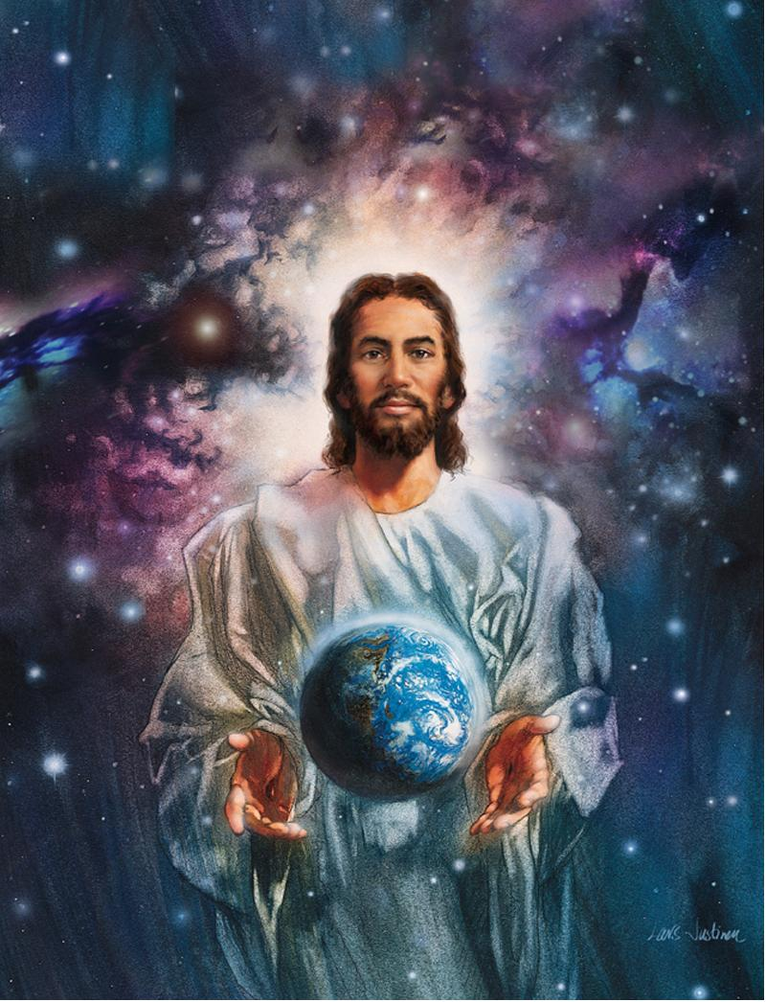
It was Jesus’ great discovery: the divinity of humanity. It was the direction of Moses’ work to lay the foundation of the move from personality to principle. This is what the Ten Commandments are all about.
In our quest for Truth we are dealing with personal growth and self-realization. It is not a matter of trying to get into God or to get God into us. Rather, it is “be still, and know that I am God.”
Jesus said: “It is your Father’s good pleasure to give you the kingdom” (Lk. ‪12:32‬).

Slide 24
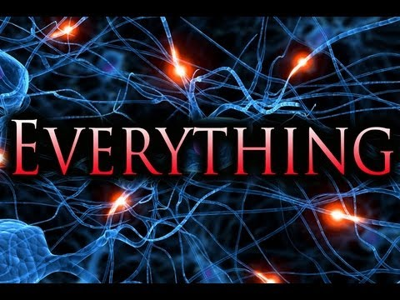
It is, not was or will be or “dear Lord let there be.”
When we break with that concept, actually break the first commandment and then we know that God is not a person to approach in servility, but a principle and process to express in expanded consciousness. Pray from the consciousness of God.
We worship God most effectively through the awareness.

Slide 25
Practice creative worth-ship – “I celebrate myself.”
Break it down every day into an awareness of “The One,” and make a daily commitment to live in that consciousness.
Practice realizing your connection to “I Am” during your meditation

Slide 26
Ideation
Ideation is the creative process of generating, developing, and communicating new ideas, where an idea is understood as a basic element of thought that can be either visual, concrete, or abstract.[1] Ideation comprises all stages of a thought cycle, from innovation, to development, to actualization…

Slide 27
Your Love Offerings Are Appreciated And Support Classes And Events At UNITY OF MELBOURNE – A POSITIVE PATH FOR SPIRITUAL LIVING!

Slide 28
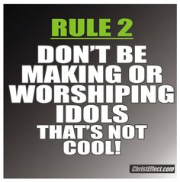
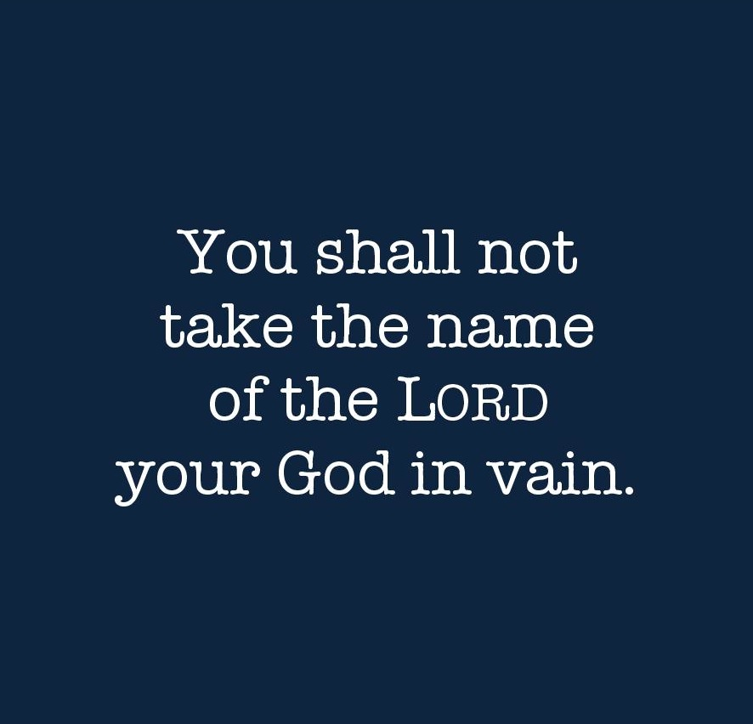
Closing Prayer / Next Week’S Assignment
For next week Commandments 2 & 3 Pgs. 29-55

