Slide 1
Breaking nine & Ten
Class 5 –The ninth and tenth commandments

Slide 2
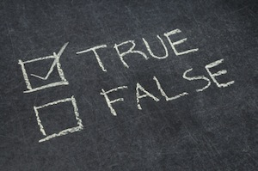
You shall not bear false witness against your neighbor (Ex. 20:16)

Slide 4
“Before you speak, let your words pass through three gates:
At the first gate, ask yourself “Is it true?”
At the second gate ask, “Is it necessary?”
At the third gate ask, “Is it kind?”
Rumi (Attributed to others as well)

Slide 6
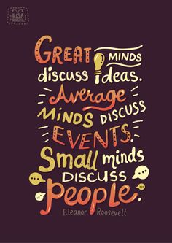
“Great minds talk about ideas, average minds talk about events and small minds talk about people”

Slide 7
Keeping this commandment calls for humility, self-honesty; to see yourself as a lifelong student on the quest. The closing lines of the Lord’s Prayer as it is commonly spoken:
For Thine is the Kingdom… all right ideas, plans, purposes come out of infinite Mind;
And the Power… the strength and creative ability to put them into operation comes from the divine flow;
And the Glory… thus all credit of accomplishment belongs to God.

Slide 8
From the perspective of metamorality you have a responsibility, as an integral part of the universe to coexist with your neighbor, to radiate to him your witness for Truth.
Bear means, “to answer.” Dictionary: something difficult to do or deal with.
Witness means old English, witan, meaning “understanding,” “intelligence,” “wisdom.”
The Hindus religion the word witness implies “seeing,” “knowing,” or what we call “consciousness.”
Criticism means, “to evaluate or establish true worth,” the original meaning has been lost. It was intended to mean not faultfinding, but looking for the good. Bearing false witness against your neighbor is criticizing him to put him down rather than to build him up. Instead of trying to help him, it is helping you to feel more adequate at his expense.

Slide 9
Truth is a nonverbal reality. We experience Truth in the depths of our being and we attempt to articulate the experience; we encode into words that which is basically a feeling. To bear witness to Truth is to know who we are and to express our true selves honestly.
The word develop does not mean to create something out of nothing, it comes from the same root as envelope. Which means to unwrap, to unfold, to release and use that which is already available within.
Whatever you desire to become you already are, for your desire is an intuitive foreshadowing of the inner reality.

Slide 10
The most obvious meaning of this commandment is not to tell lies about other persons. But it also pertains to a tendency to express false or harsh judgments toward others, Jesus taught that human judgments will always react in kind upon the one who judges. This does not mean we are not to judge. It means only that we should judge others only as we would be willing to be judged.
Perhaps the main reason why we bear "false witness" or express harsh judgments is because we constantly mistake a part for the whole. In other words, we seldom view another person in their wholeness, but only in the aspect of the moment. Very often this can be negative. The biggest mistake of all is to label anything negative in another person as a finality. This is false judgment, or "false witness."

Slide 11
The Tenth Commandment
You shall not covet your neighbor’s house; you shall not covet your neighbor’s wife, or his man-servant, or his maid-servant, or his ox, or his ass, or anything that is your neighbor’s
(Ex. 20:17).
“Appreciate what you have and what you are… Be Grateful!”

Slide 13
One of the most difficult words to translate in the Ten Commandments is “covet,” which can be rendered as “scheme against.” In Hebrew, this word has the connotation of “desire.” This translation also reveals multiple outlooks of the commandments meanings.
To covet means to desire negatively. Desire in itself is good. It is an intuitive feeling that a certain form of good is right for us. But desire can be taken negatively--then it becomes coveting.
We covet when we want the good that another person has, to the extent that we become selfish and unhappy in our feelings. If we are willing to take that good away from the person, even though it deprives him, we are coveting. Coveting, like stealing, is quite unnecessary. Each person can experience his own highest good under the laws of consciousness. There is one Source of all good, and each person is one with that Source. Instead of stealing… pray. Instead of coveting… pray.

Slide 14
From a purely moral point of view the commandments are codes for improving conduct and also for changing character and from a metamoral point of view they contain hidden keys for modifying consciousness.
It is bringing it to a more positive attitude toward covet, which has the same root as cupid, which means love or passion. It is to desire to want passionately. What are you desiring or passionately wanting? If it is worldly we could think of it as an attachment to something physical. If we are thinking of it as a passion for life for feeling love or happiness it is a more whole way of living. As you mature spiritually you discover that your flow comes from with in.
As Butterworth says, “Our desire to have becomes a desire to be.

Slide 15
Another aspect of this commandment that could easily be neglected; students of this new insight in Truth may assume that we are beyond materialistic covetousness, for we are working with spiritual law; “metaphysical coveting;” the widespread materialization of the spiritual laws of prosperity. Through techniques of “demonstration” it is assumed that one can have anything he can “treat” for. There is a subtle rationalization of our old covetous ways, simply “putting new wine into old wine-skins. We are working with spiritual law to acquire the things.

Slide 16
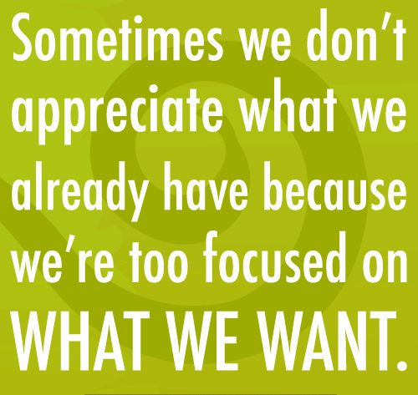
“Seek not to be superior to other persons, but to be superior to your former self.” In other words, get off the competitive treadmill. Envy is caused by the desire to be like the other, for we think that what he has is the reason for what he is. You cannot be someone else … or even be like him. You can only be you.
“The place on which you are standing is holy ground” (Ex. 3:5). Wherever you are, you are in the center of the divine flow. The great need is to take time to get yourself centered in it.
Appreciate what you have and what you are.

Slide 17
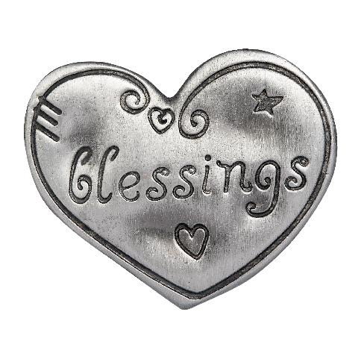
Carlyle says It is a good slide rule by which to determine how rich you are: All that you love and bless (not covet) and all that actually blesses you.
Break the code and find the keys to personal power. Butterworth offered some clues. You will find others. It will be significant only if you make a commitment to work for the changes of consciousness that each commandment suggests.

Slide 18
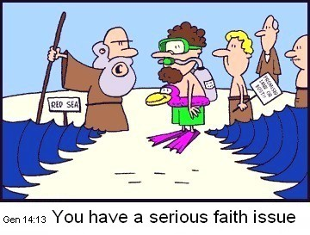

Slide 19
Final Word On Moses
The promised land symbolizes a level of consciousness better than that meant by "Egyptian bondage." The promised land is Canaan. Canaan is by no means "the kingdom of heaven" talked about by Jesus, but Canaan is a higher and better level than Egyptian bondage. The metaphysical meaning of Canaan is complex. In the Metaphysical Bible Dictionary it is defined as "the body consciousness," "the subconsciousness," "the invisible substance that surrounds and interpenetrates all forms, of which it is the matrix." So you see why we call it complicated!
In Num. 20:10-12 we are told that Moses is not to lead the Israelites into the promised land. In Deut. 34:5-7, we are told of the death of Moses at the age of 120! Moses is succeeded by Joshua as leader of the Israelites.
The metaphysical reason that Moses does not enter as leader into the promised land is that Moses stands for only a certain degree of spiritual awareness, concerned mostly with the letter and mechanics of the law of cause and effect. While this is a good and necessary stage of soul growth, it does not suffice beyond a certain point. Knowledge of the letter of a religious teaching can take us so far, but no further.
Basically, Canaan appears to be a level of consciousness on which we encounter new possibilities for further growth. We are no longer in bondage of gross materiality, sensuality, and ignorance (Egypt), but we are not yet in the higher levels of spiritual understanding (Jesus Christ). We are definitely on the right path, but there will be mistakes and challenges. There will be much learning and growing, and much to look forward to!

Slide 20
Thank You For Joining Me In This Adventure of Ancient Wisdom!
Closing Prayer and Love Offering

